Slide 1



JavaScript ES6 – Promises & Collections
Mark J. Buckler
OCPJP,CIWJS

Slide 2

Credits
Some of the contents of this slide presentation have been referenced and reproduced, from Switching to ES6 in Node.js, by Ryan Lewis, ©2017 LinkedIn Corporation.

Slide 3
LEARNING OBJECTIVES
Introducing Promises
Aggregating Async Operations with Promise.all()
ES6 Sets
ES6 Maps

Slide 4
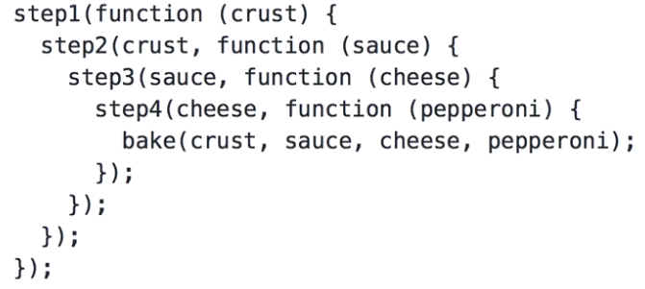
Introducing Promises
Callbacks
A fundamental design pattern for writing code in JavaScript and Node.js
Quite easy in simple cases, Callback Hell when complex
As complexity grows, causes code to become extremely convoluted and difficult to understand

Slide 5
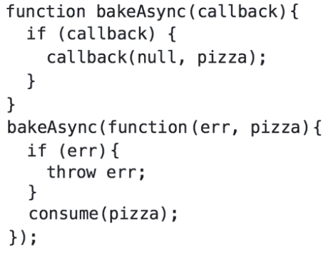
Introducing Promises
Typical ES5 Callback Implementation
Usually, first argument is error, second is data

Slide 6
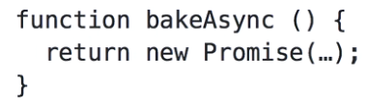
Introducing Promises
Promises
ES5 Implementation
An alternative solution to callbacks
Implemented by third-party libraries such as Q and Bluebird
ES6 provides a native implementation with a simple design pattern
Promises go back to the concept that a function should return something
Instead of passing in a callback, you get back a Promise as a returned object

Slide 7
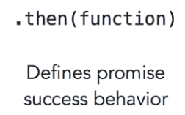
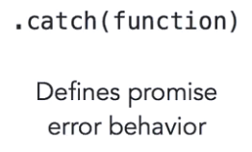
Introducing Promises
Promises
The return calls the constructor for a new Promise object
The returned object has a very simple API
Consists of two methods, each with a specific purpose

Slide 8
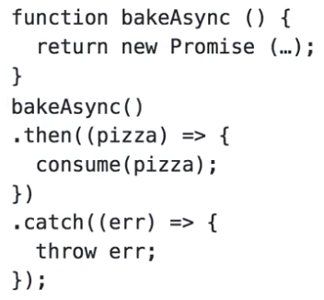
Introducing Promises
ES6 Promise Pattern
Function returns Promise object, chains the function calls for .then and .catch
Clear asynchronous contract established

Slide 9
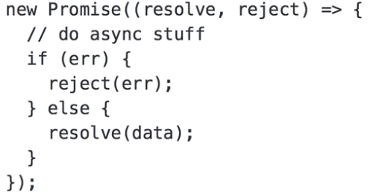

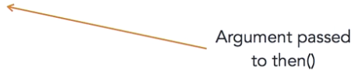
Introducing Promises
Implementing a Promise Object
Argument to a Promise constructor is a function which accepts two arguments
One typically called resolve
One typically called reject

Slide 10
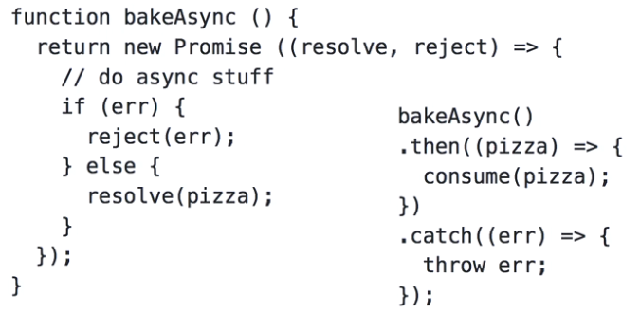
Introducing Promises
Complete Promise Example

Slide 11
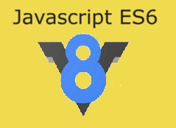
Introducing Promises
Programming Exercise03_03_01 – Step 1
Replace Callbacks with Promises

Slide 12
Introducing Promises
Programming Exercise03_03_01 – Step 2
Use the New Promises

Slide 13
Introducing Promises
Programming Exercise03_03_01 – Step 3
Replace More Callbacks with Promises

Slide 14
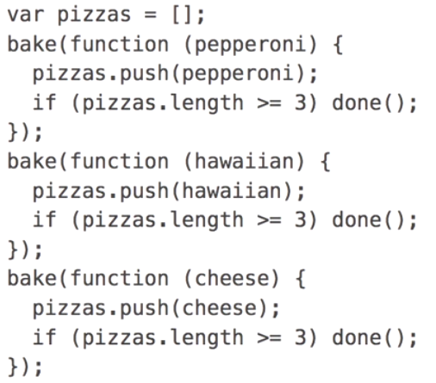
Aggregating with Promise.all()
Asynchronous Callbacks in Parallel

Slide 15
Aggregating with Promise.all()
Promise.all()
A collection of Promise returning objects is passed to it as an argument
Returns a single Promise, which resolves under two conditions
Once all have been completed
In the case that any of them errors
The resulting Promise receives a .then call with an array of results in the same sequence as the original collection
Rejection from any of the collection results in the .catch receiving a reject argument

Slide 16
Aggregating with Promise.all()
Programming Exercise03_03_01 – Step 4
Aggregating Async Operations with Promise.all()

Slide 17
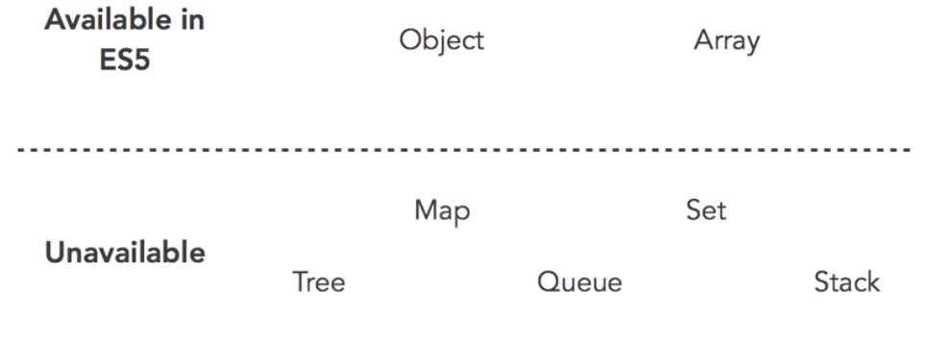
ES6 Sets
Data Structures in JavaScript
JavaScript ES5 has always had a limited number of data structures
Arrays and objects
ES6 has increased the availability with Set and Map

Slide 18
ES6 Sets
Set
A Set is a collection of unique values of any data type
There can be no duplicates
If a duplicate is inserted into the Set, nothing happens
Constructing a Set with an iterable object var mySet = new Set([3, 1 ,7, 5, 9]);
Constructing an empty Set var mySet = new Set();
A Set is sorted in the order of insertions

Slide 19
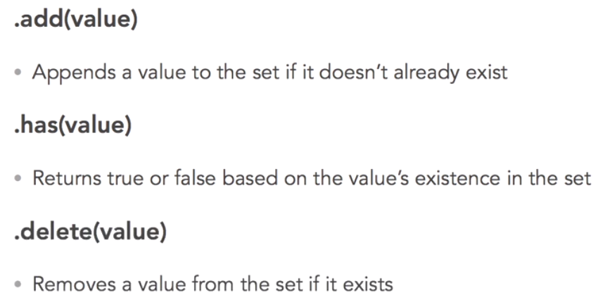
ES6 Sets
Common Set API Methods

Slide 20
ES6 Sets
Set
Accessing values
Cannot be accessed directly as in an array
There are no indexes, you must use an iterator
More on iterators in the next unit

Slide 21
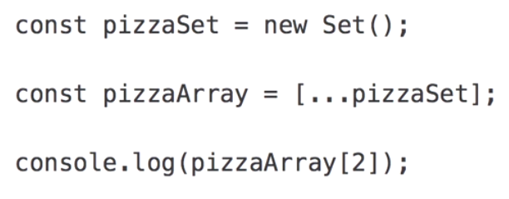
ES6 Sets
Set
Spread syntax may be used to convert a Set into an array for direct access

Slide 22
ES6 Sets
Programming Exercise03_03_01 – Step 5
Implementing ES6 Sets

Slide 23
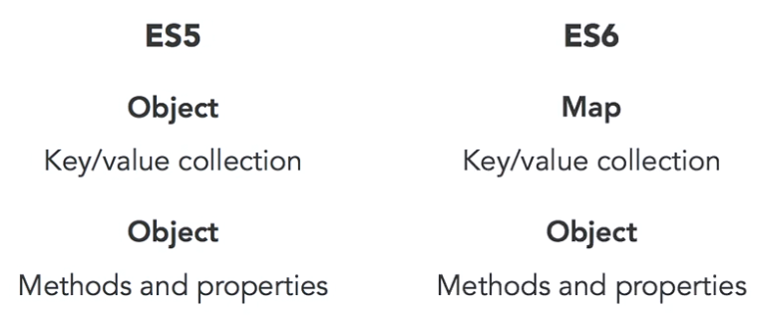
ES6 Maps
Map
A map-like data structure has always been a part of JavaScript, the object
However, it was used to cover two purposes
ES6 has introduced specialization with Map

Slide 24
ES6 Maps
Map
A Map is a collection of key-value pairs
A Map is a collection of elements, not a new data type
Any data type may be used as the key
Does not have to be a string as in an object.
A Map has a .size property containing the count of elements in the collection
A Map is sorted in the order of insertions

Slide 25
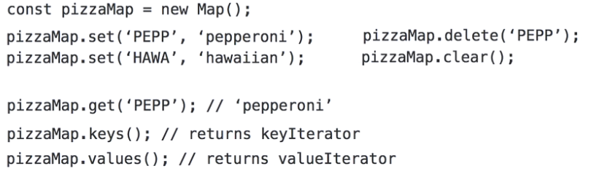
ES6 Maps
Common Map API Functions
More on iterators in the next unit

Slide 26
ES6 Maps
Programming Exercise03_03_01 – Step 6
Implementing ES6 Maps

